Slide 1


Slide 2
DEVOPS USING AI
Task Automation → Troubleshooting → Learning

Slide 3
1. Understand Your Goals
Before you ask the AI, define what you want to achieve. For example:
Task Automation: Do you need to automate a deployment process?
Troubleshooting: Are you trying to diagnose a failing pipeline?
Learning: Do you want an explanation of how a particular tool (e.g., Docker, Kubernetes) works?

Slide 4
2. Craft Clear and Specific Prompts
A well-crafted prompt should include:
Context: Briefly explain the background.
Specific Requirements: State exactly what you need.
Desired Format: If you need code, configuration files, or a step-by-step guide, mention that.

Slide 5
Prompt Example 1: Generating a CI/CD Pipeline Script
Prompt:
"I'm working on a Node.js project and need to create a Jenkins pipeline. I want stages for installing dependencies, running tests, and deploying the app. Could you generate a sample Jenkinsfile with comments explaining each stage?"

Slide 6
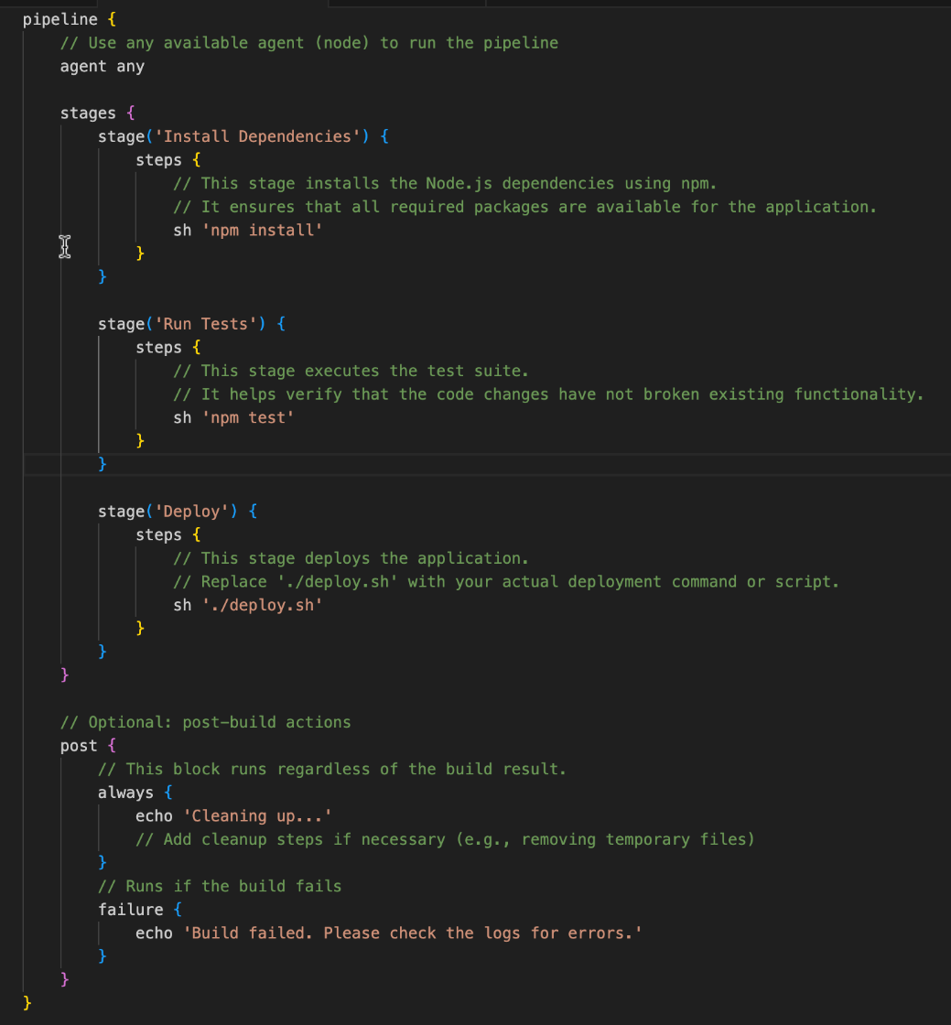
Below is an example Jenkinsfile for your Node.js project. It includes three stages—installing dependencies, running tests, and deploying the app—with inline comments to explain each step:
Explanation
agent any: Tells Jenkins to run the pipeline on any available agent.
Stage: Install Dependencies: Uses npm install to install project dependencies.
Stage: Run Tests: Executes npm test to run your test suite.
Stage: Deploy: Executes a deployment script (./deploy.sh), which you can replace with your specific deployment commands.
Post: Includes cleanup and failure handling steps.

Slide 7
Prompt Example 2: Creating Infrastructure with Terraform
Prompt:
"I need a Terraform script to deploy an AWS EC2 instance. The instance should be part of a specific security group, use a given AMI, and have a specified instance type. Please include comments for each section so I can learn how the configuration works."

Slide 8
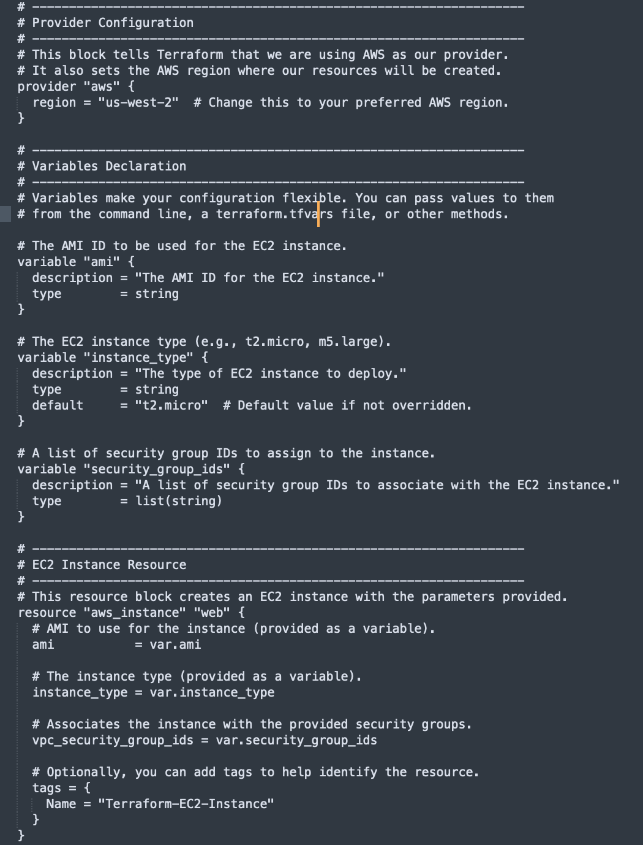
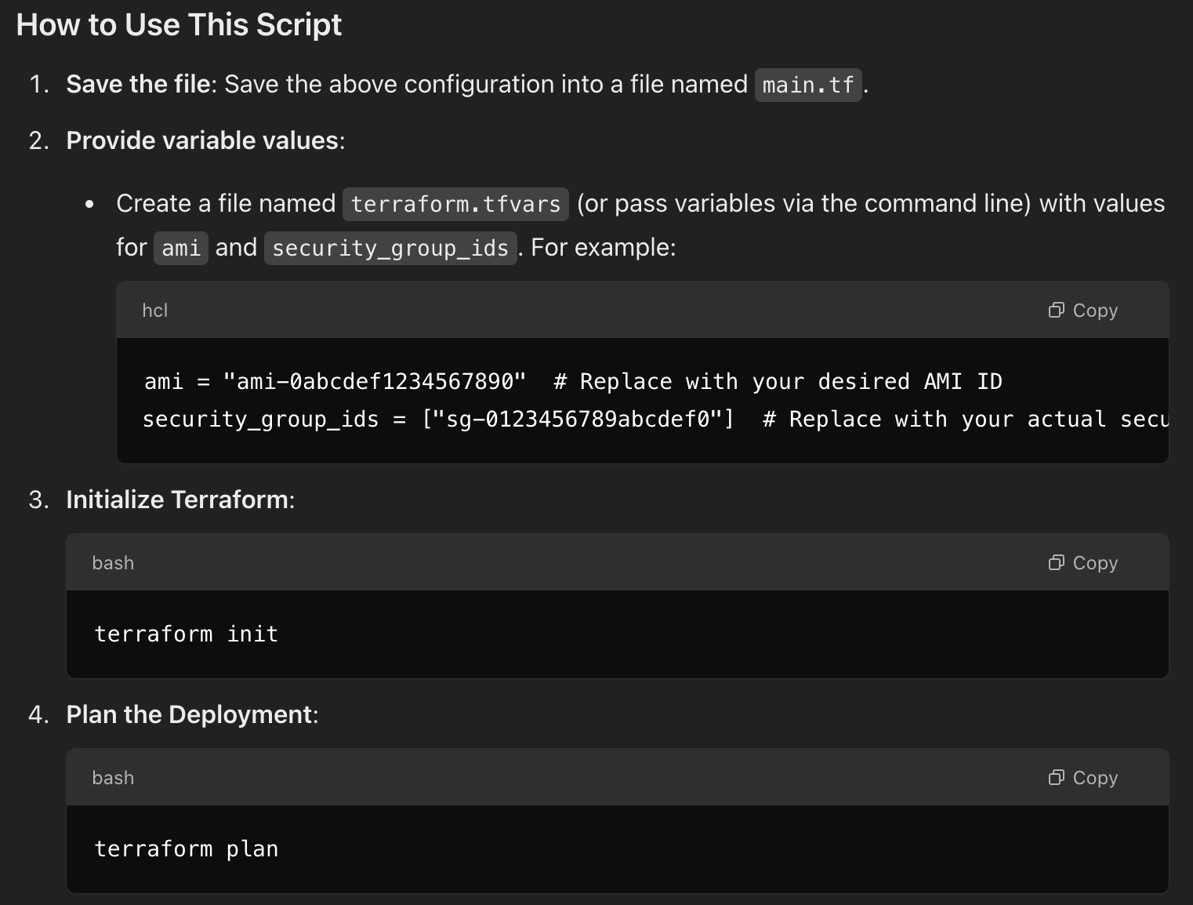
Below is a sample Terraform configuration that deploys an AWS EC2 instance using a specified AMI, instance type, and security group. Each section includes comments to help you understand what each part does.

Slide 9
Prompt Example 3: Dockerfile for a Flask Application
Prompt:
"I'm building a Python Flask application and need a Dockerfile. The Dockerfile should set up a virtual environment, install the dependencies from a requirements.txt file, and run the Flask app on port 5000. Please include best practices and comments."

Slide 10
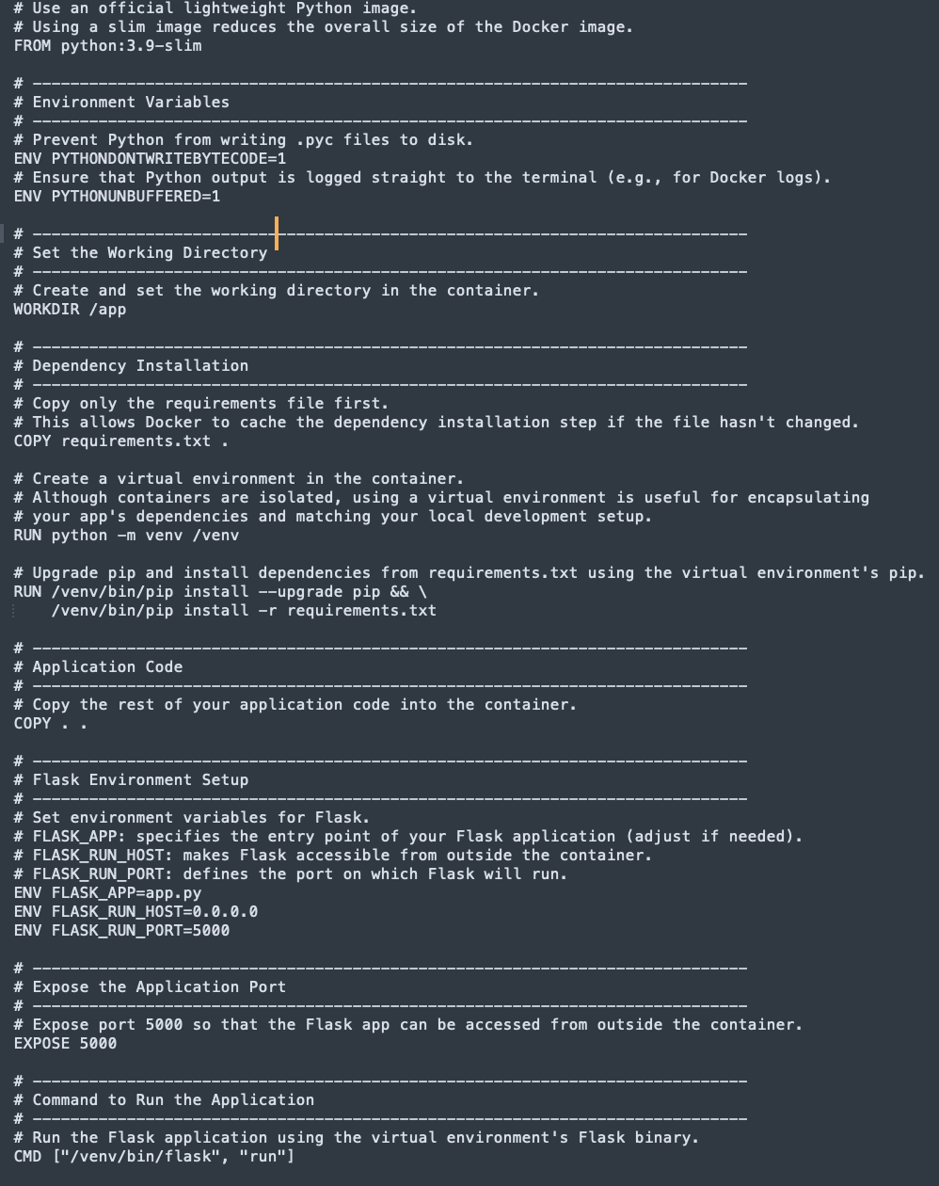
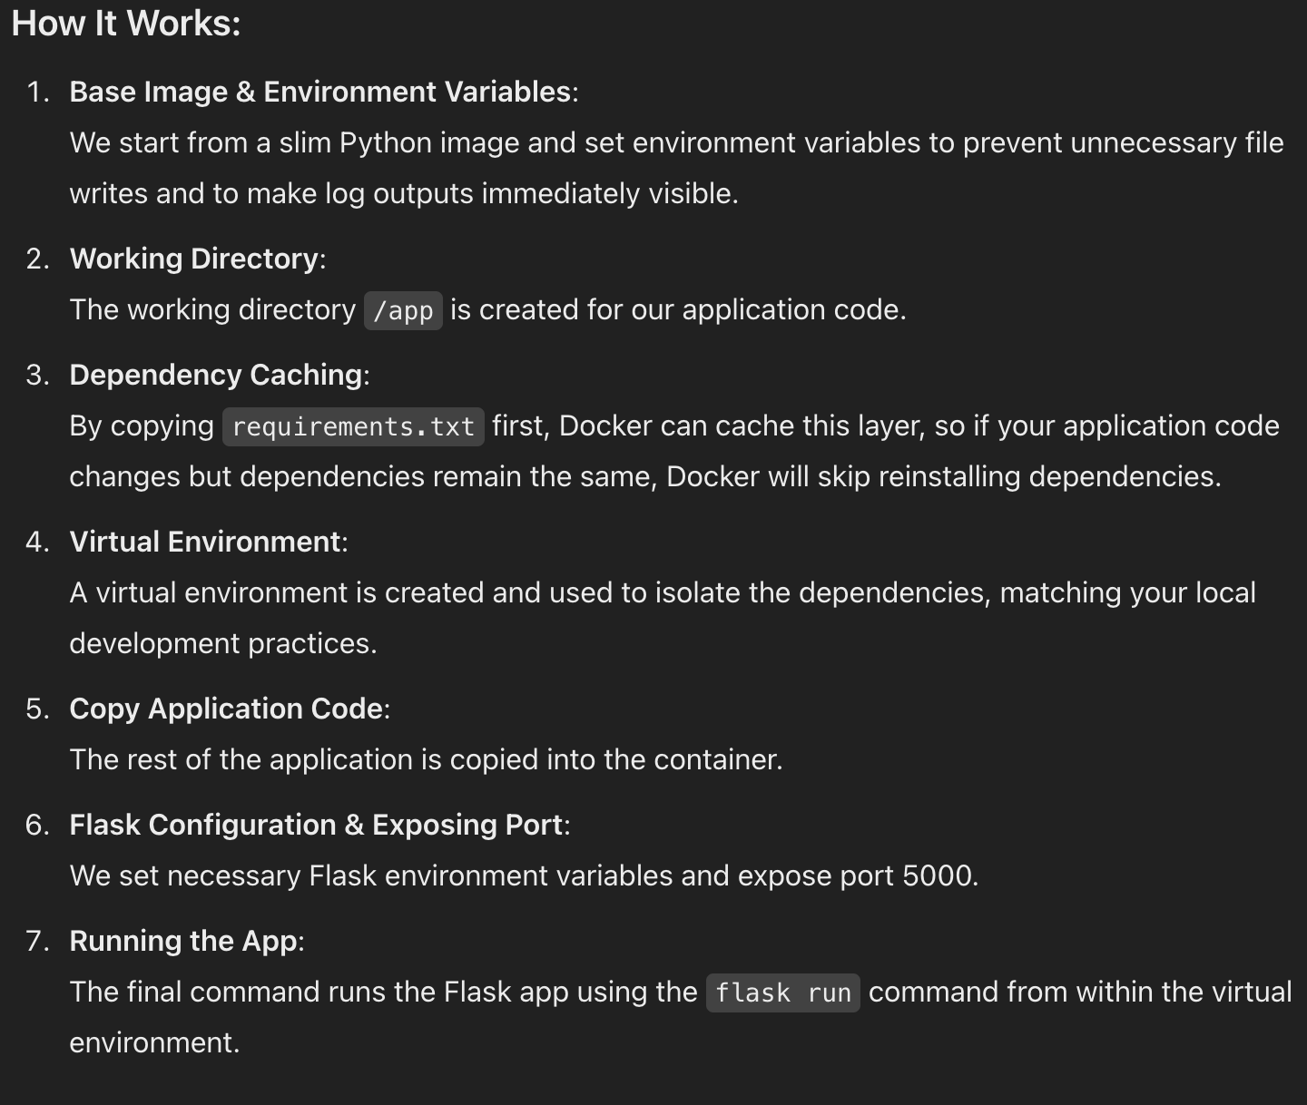
Below is an example Dockerfile that sets up a Python Flask application with a virtual environment, installs dependencies from a requirements.txt file, and runs the Flask app on port 5000. Comments are included throughout to explain each best practice and configuration step.

Slide 11
Prompt Example 4: Troubleshooting a CI/CD Pipeline Issue
Prompt:
"My Jenkins pipeline fails during the test stage with an error related to npm dependencies. The error message mentions a missing module. Can you provide some troubleshooting steps or a possible solution for this problem?"

Slide 12
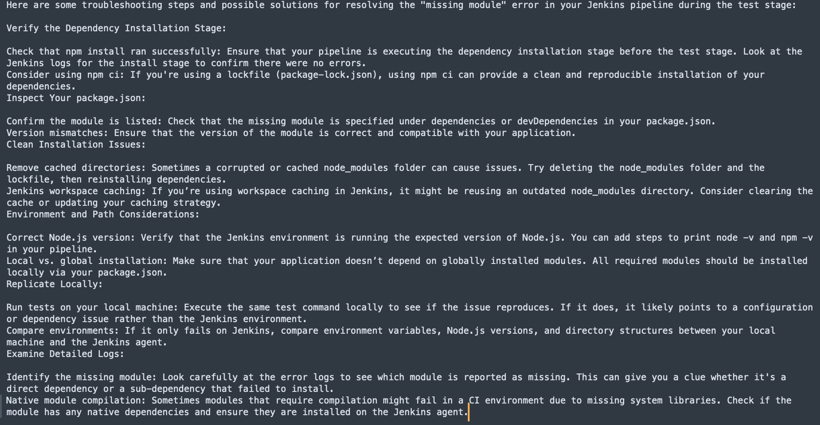
Here are some troubleshooting steps and possible solutions for resolving the "missing module" error in your Jenkins pipeline during the test stage:

Slide 13
Practical Workflow
Identify the Task: Example: Automating deployment or fixing a pipeline error.
Draft a Detailed Prompt: Include context, requirements, and desired format.
Review the Output: Ensure the AI’s response meets your needs.
Ask Follow-Ups if Necessary: Refine your request for better accuracy.
Implement and Learn: Use the provided solution as a learning tool, reviewing comments and explanations.

Slide 14
Simple Project using JENKINS

Slide 15
"Message Printer"
Goal: Create a Jenkins job that runs a shell script to print "Jenkins is awesome!" and verifies the output.

Slide 16
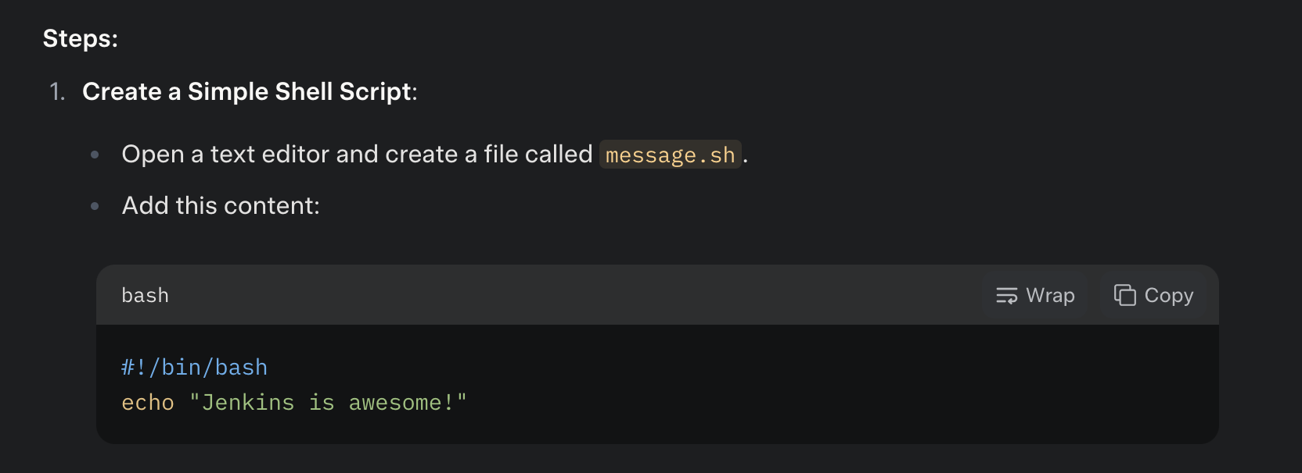
What You’ll Need:
Jenkins installed (e.g., on http://localhost:8080 if local).
A basic text editor to create a script.
Optional: A Git repository if you want to pull the script from there.

Slide 17
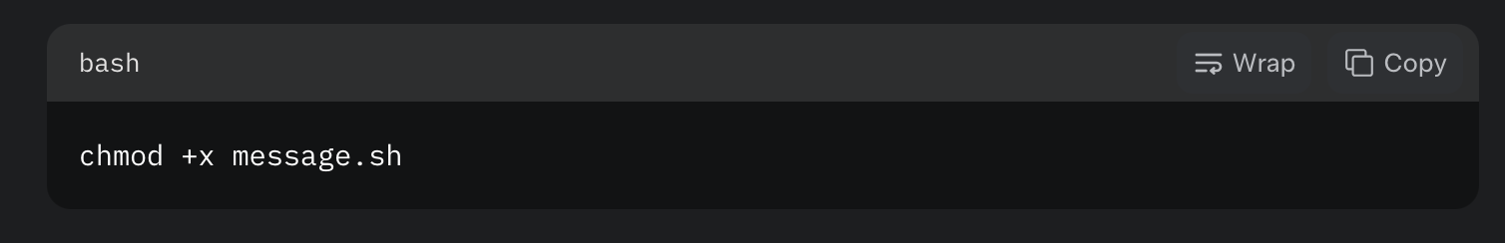
Save it somewhere Jenkins can access (e.g., your local filesystem like /home/user/jenkins-projects/message.sh).
Make it executable by running this in your terminal:
Optional: Use Git:
If you want to practice with Git, create a repository (e.g., on GitHub), add message.sh, and push it. For simplicity here, I’ll assume you’re using a local file, but I can adjust if you prefer Git.

Slide 18
Set Up the Jenkins Job:
Open your Jenkins dashboard (e.g., http://localhost:8080).
Click New Item on the left sidebar.
Enter a name like "SimpleMessagePrinter".
Select Freestyle project and click OK.

Slide 19
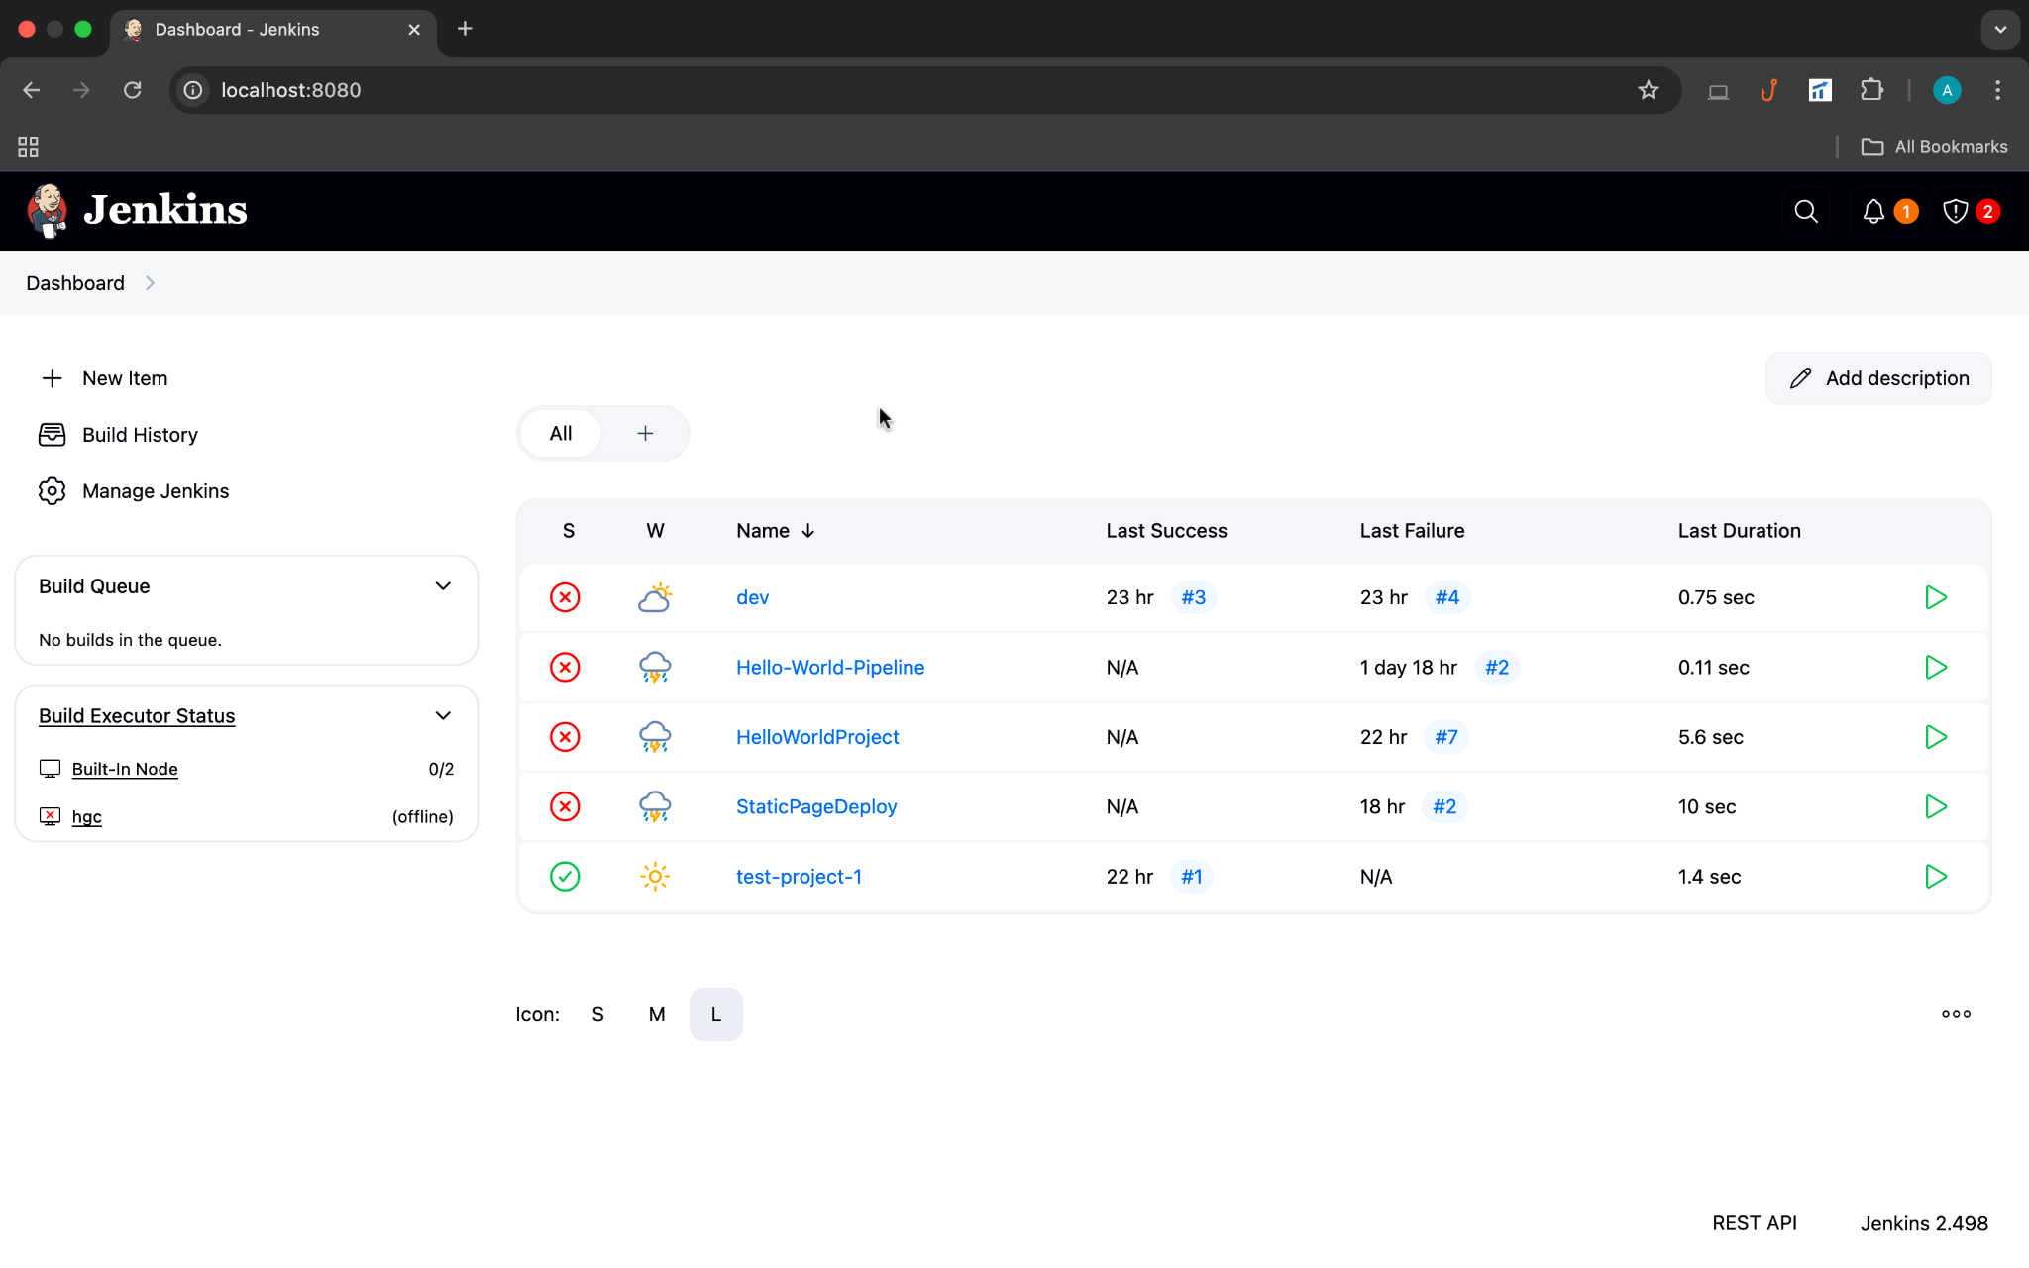

Slide 20
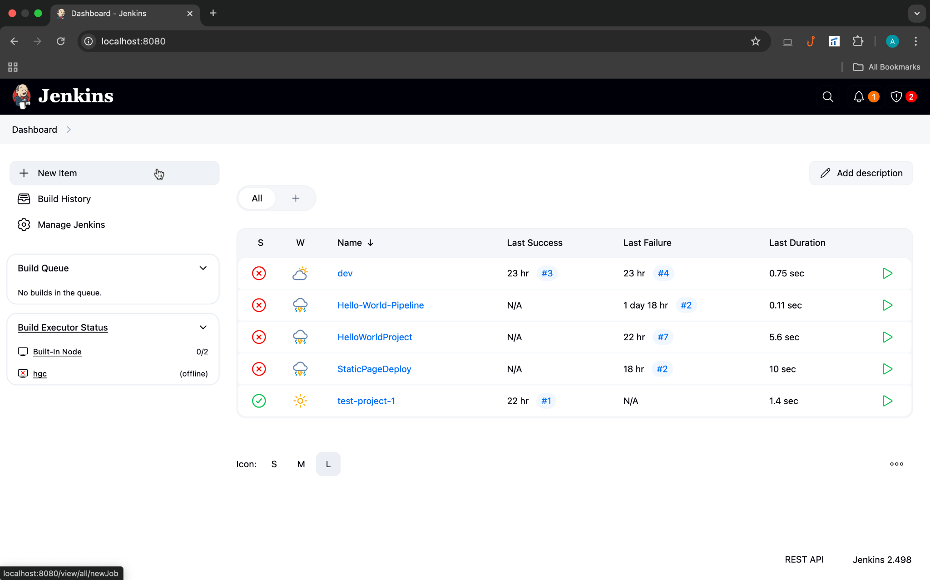

Slide 21
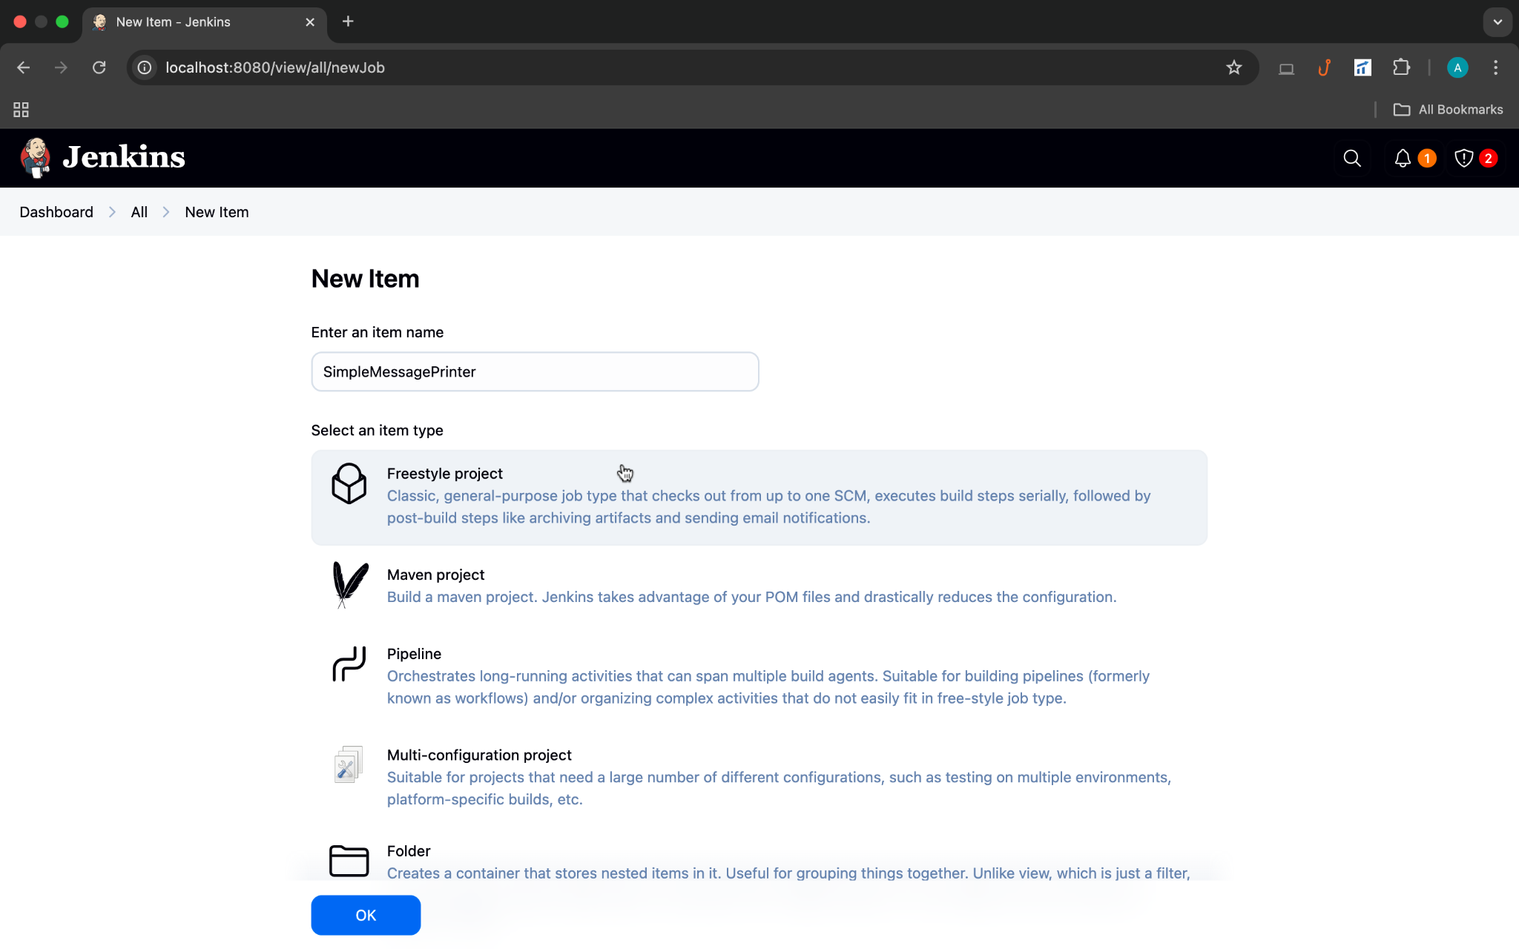

Slide 22


Slide 23
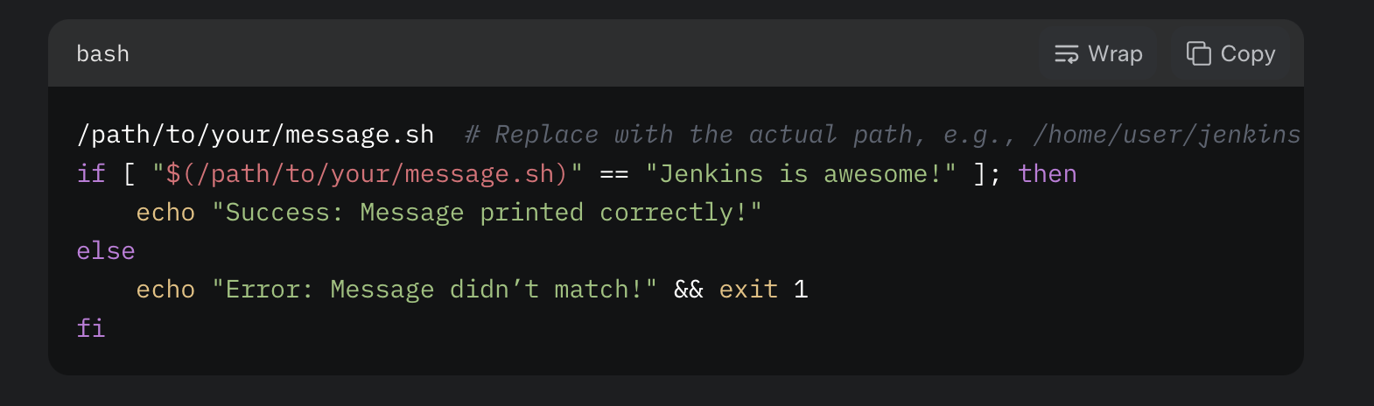
Configure the Job:
Scroll down to the Build section.
Click Add build step and select Execute shell.
In the command box, type:
This runs the script and checks if the output is correct. Replace /path/to/your/message.sh with wherever you saved it.

Slide 24
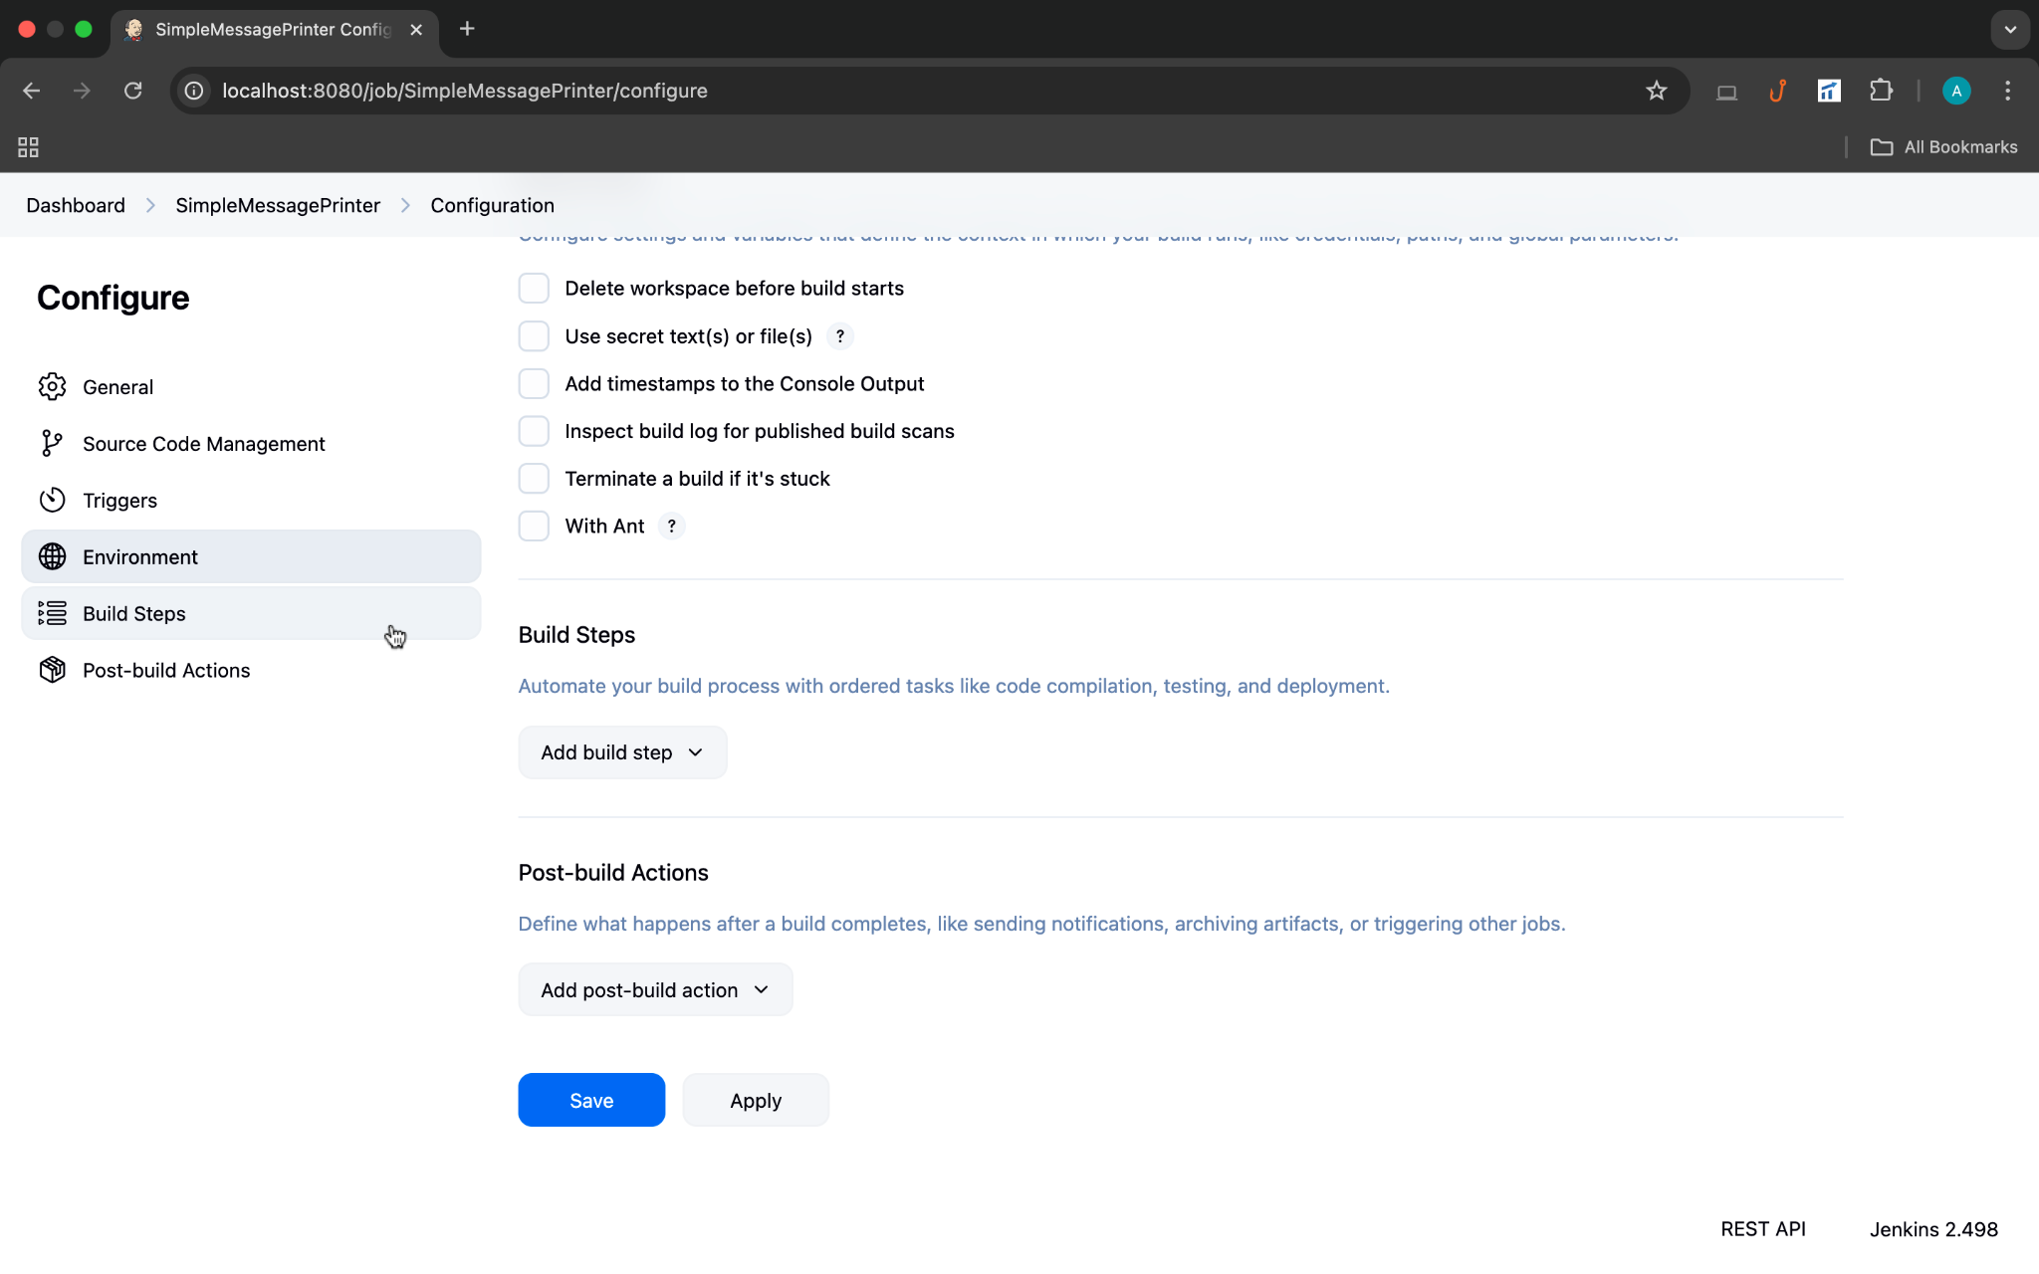

Slide 25
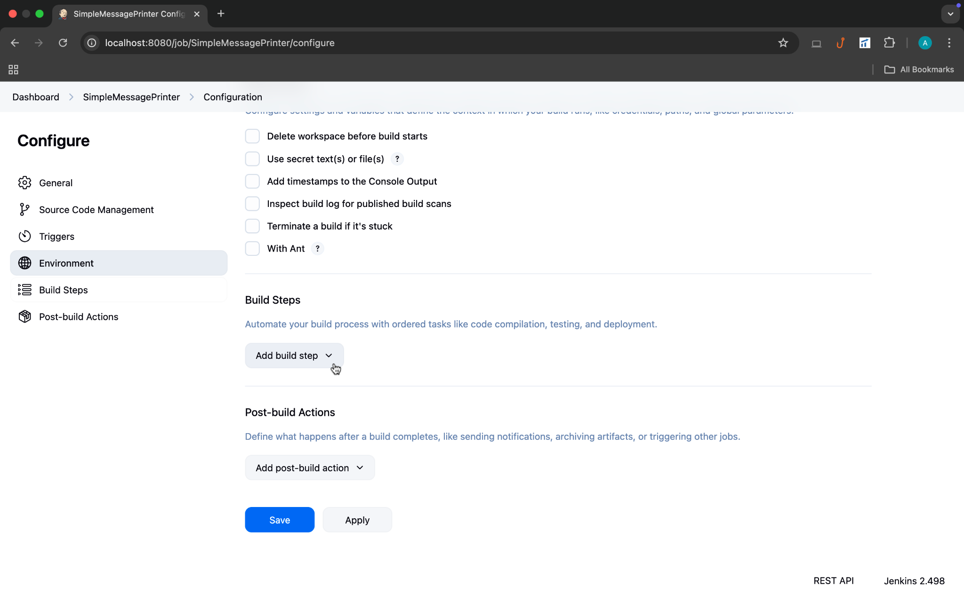

Slide 26
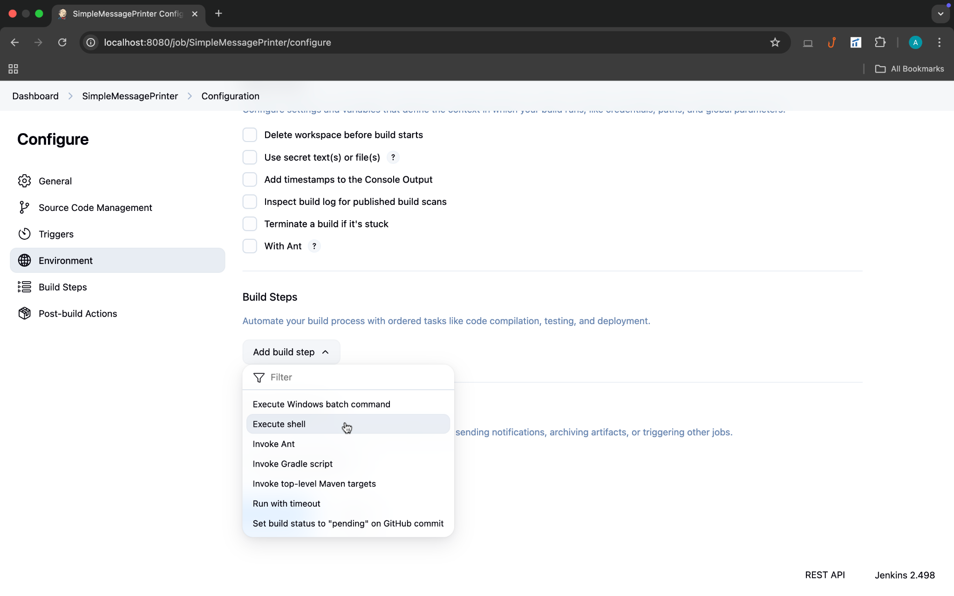

Slide 27
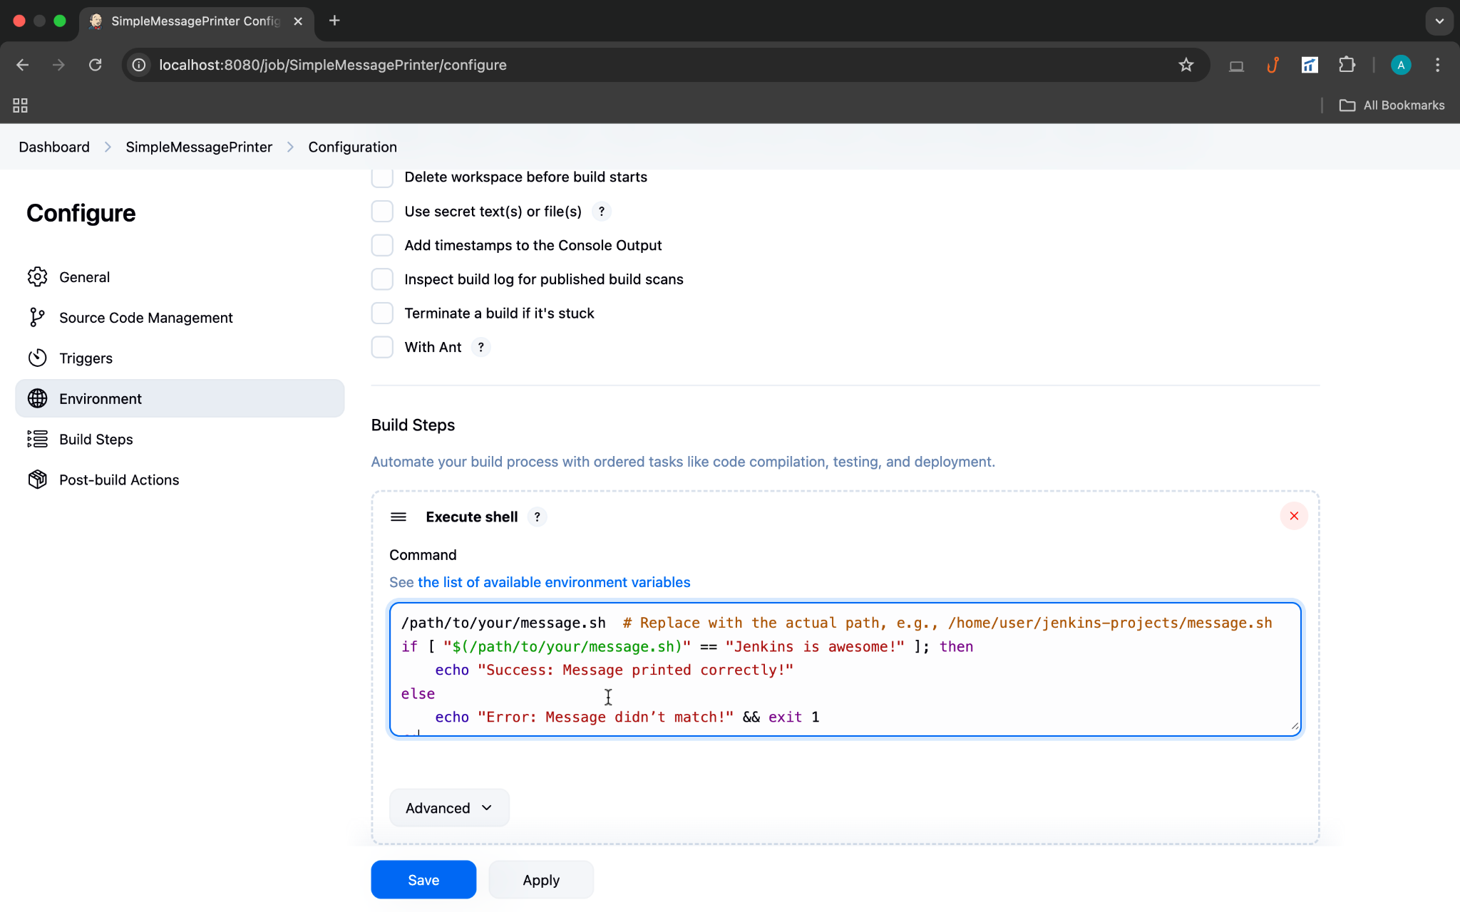

Slide 28
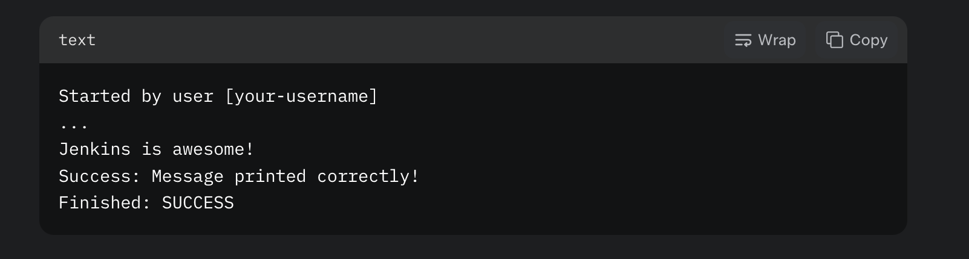
Save and Test:
Click Save at the bottom.
On the project page, click Build Now.
Once the build runs, click the build number (e.g., #1) in the Build History section, then select Console Output.
You should see:

Slide 29
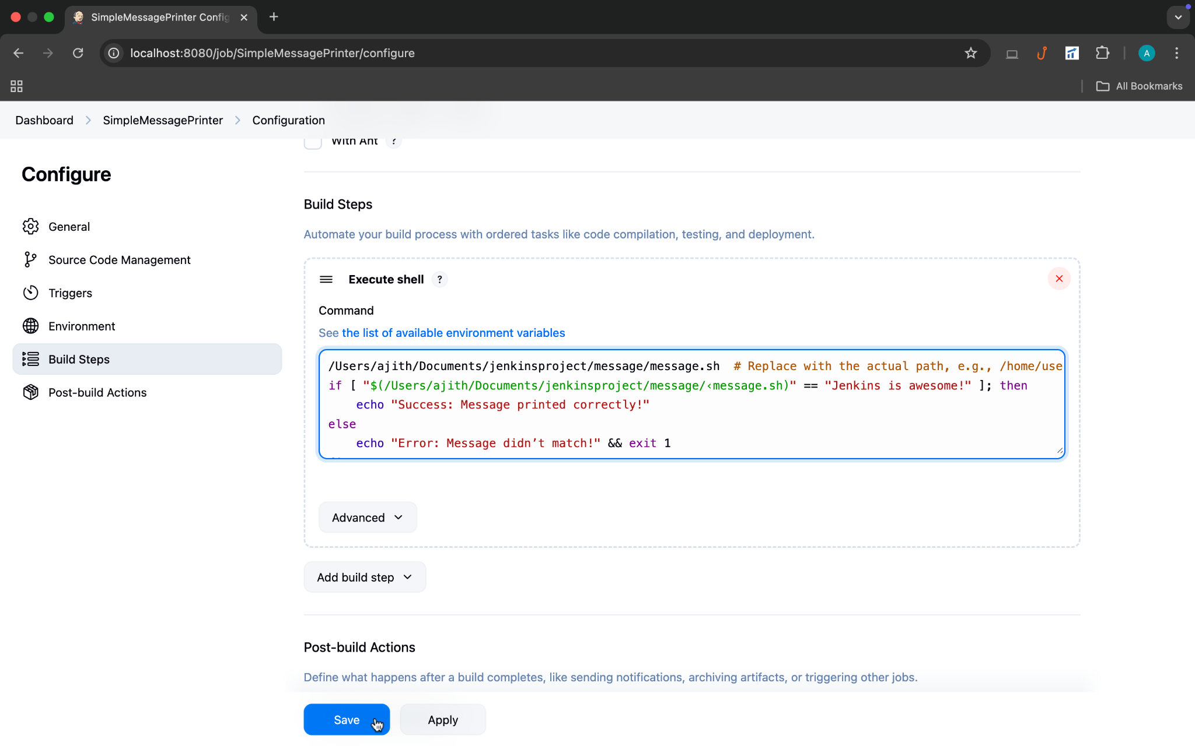

Slide 30
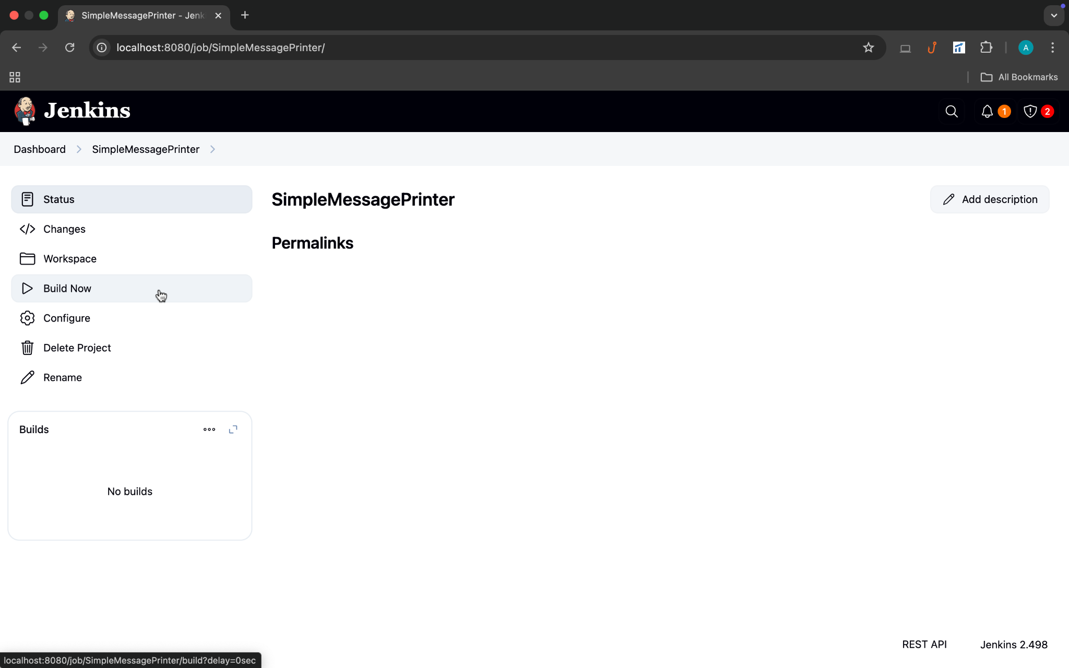

Slide 31
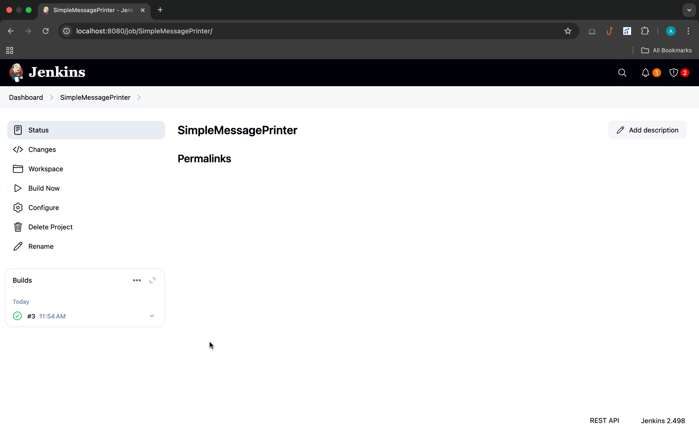

Slide 32
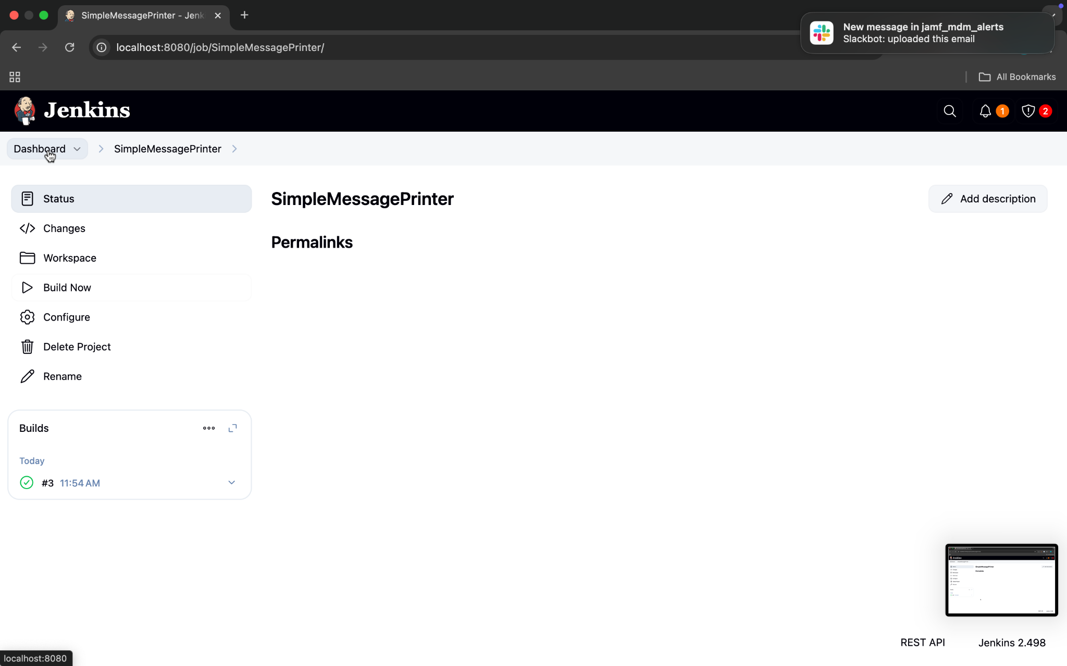

Slide 33
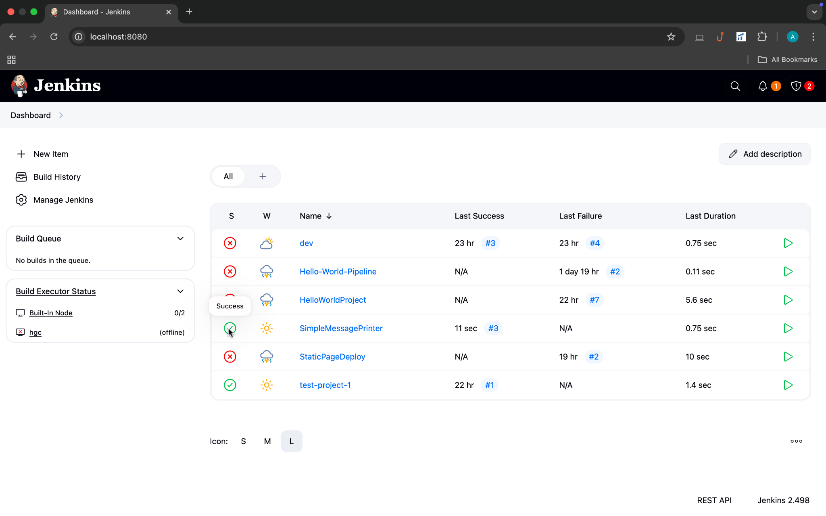

Slide 34
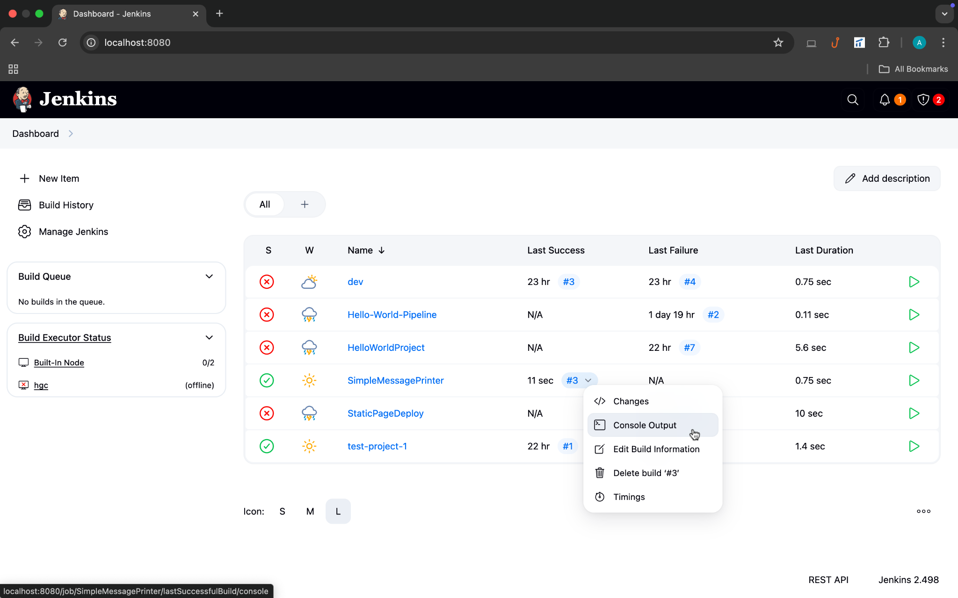

Slide 35
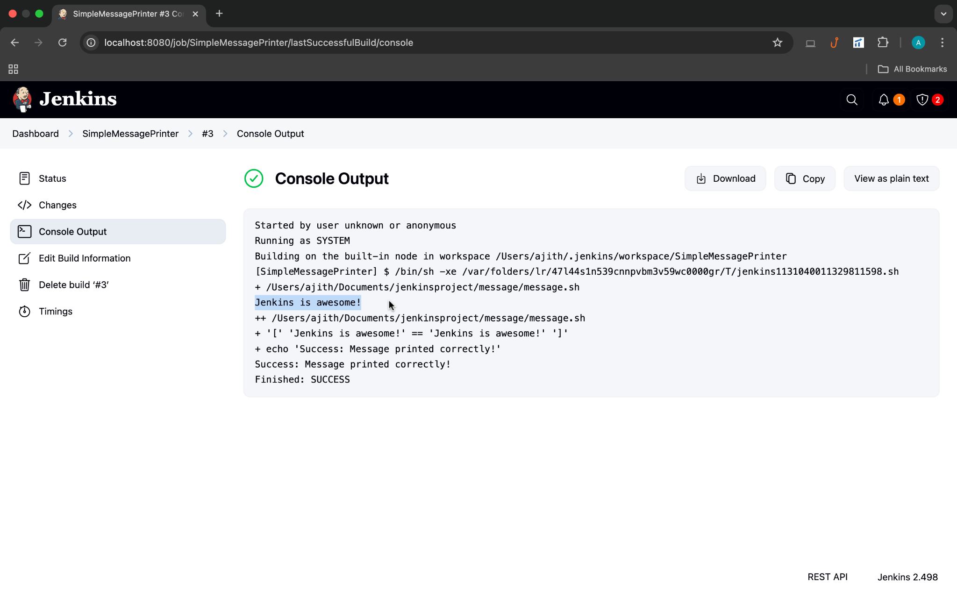

Slide 36
What This Does:
The job runs your message.sh script.
It checks the output to ensure it says "Jenkins is awesome!".
If it matches, you get a success message; if not, the build fails (handy for learning how Jenkins handles pass/fail).

Slide 37
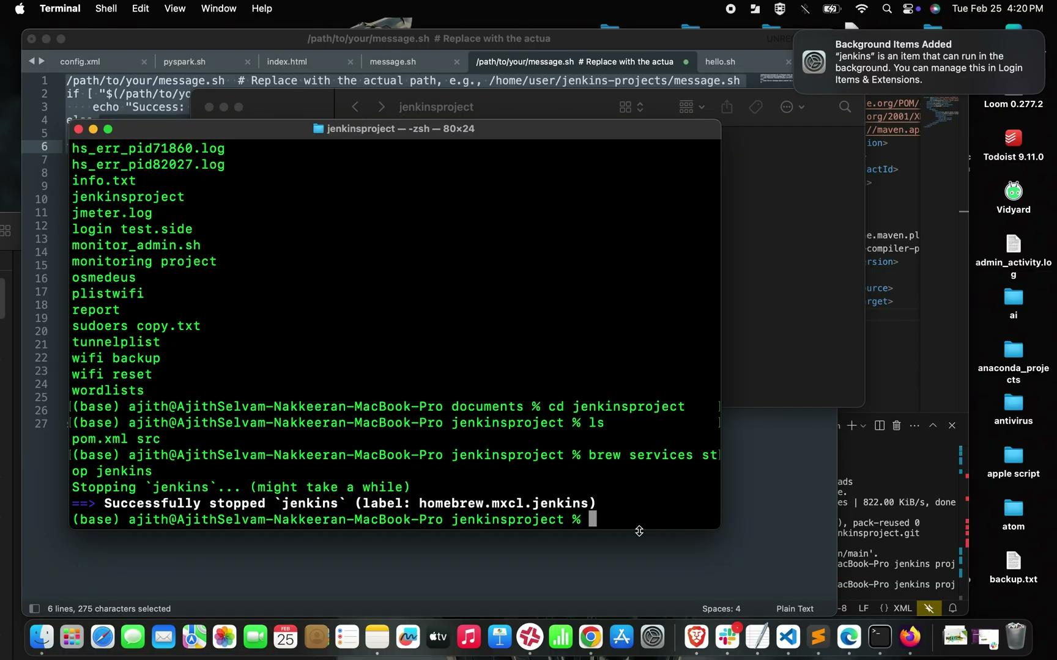

Slide 38
Summary
Be Specific: Detailed prompts yield detailed responses.
Include Context: More context helps the AI understand your environment.
Iterate: Don’t hesitate to refine or ask follow-up questions.

Slide 39


